Slide 1
A Competitive Review of Huawei Storage and Key Values to Our Customers Boston Storage Solution Group June 2020

Slide 2
A Competitive Review of Huawei Storage and Key Values to Our Customers Boston Storage Solution Group June 2020

Slide 3
OceanStor Dorado

Slide 4
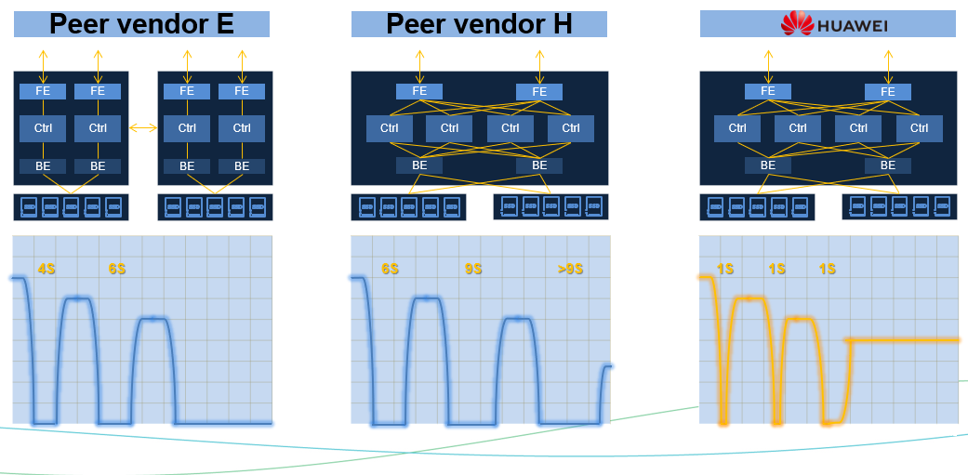
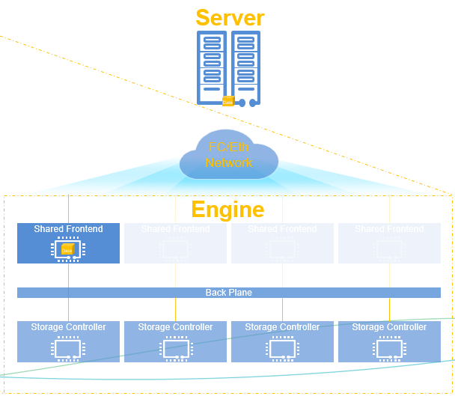
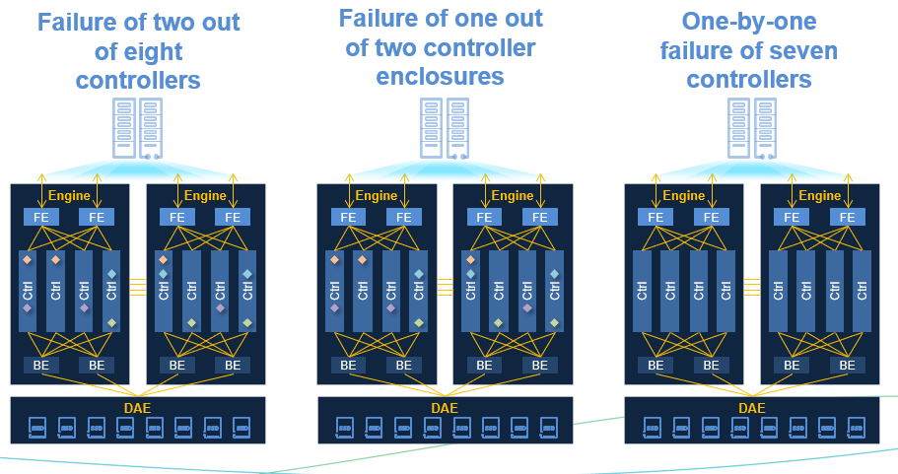
Dorado Competitive Edge – Front End
1 second controller failover
Shared front-end adaptor
Best controller failure tolerance (7/8)
Front End
Inside
Back End
Outside
Management
Notes:
Key message: Front end is key to both performance and business continuity
Dorado’s 1 second controller failover time is industry leading
Compare the numbers to show the gap
How was this achieved? Explain how a shared FE adaptor (fully meshed front end) helps
Benefit: host (client) will not see FC session breakage during failover, no need for session re-login
Highlight that we can tolerate 7 out of 8 controller failure, more details in next slide (Back end)

Slide 5
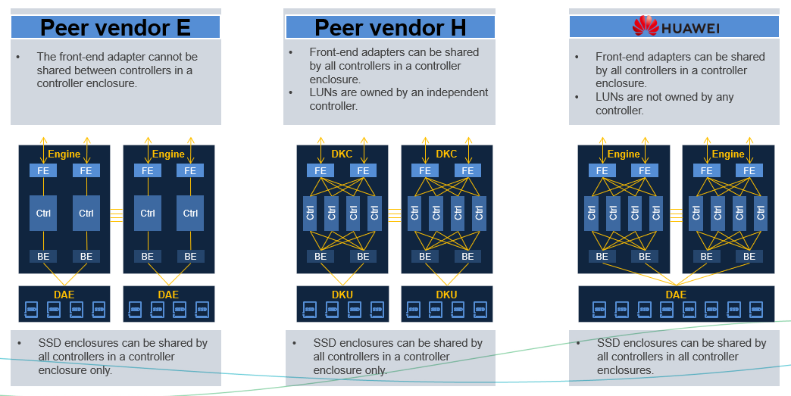
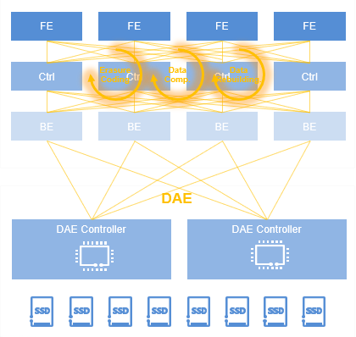
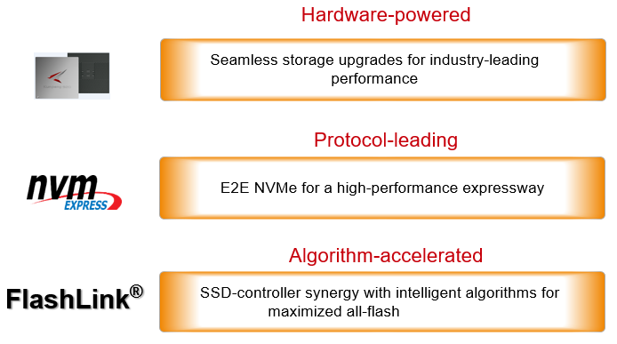
Dorado Competitive Edge – Back End
Fully connected back ensures best reliability and enables end-to-end load balancing
Intelligent DAE offload EC/compression/dedup
End-to-end NVME with unique FlashLink acceleration
Front End
Inside
Back End
Outside
Management
Notes:
Key message: Back end is how we achieve the magics presented to customers (hosts)
Highlight Dorado’s full mesh connected backend, analyze gaps between Dorado and peer, this is why we can do 7 fail out of 8
Smart DAE is a unique feature of Dorado, or at least the amount of offloading we do, highlight EC/dedup/compression are all offloaded, so controller CPU can be dedicated to I/O processing and other business logic
Highlight E2E NVME enables much shorter I/O pathway, make it possible to achieve 20M IOPS and 100us I/O latency. Mention SPC-1 benchmark
Ask audience to throw some thoughts on relationship between throughput and latency

Slide 6
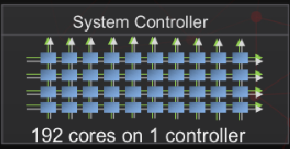
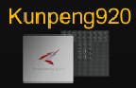
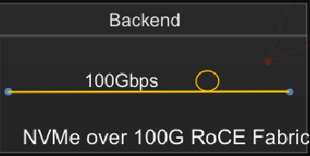
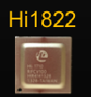
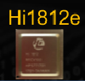
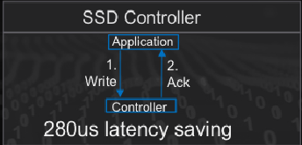
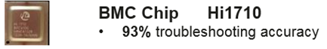
Dorado Unique Competitive Edge - Flashlink™ Hardware
High Performance CPU
High speed 100Gps.
Low latency
RDMA/FC/Eth/InfiniB/TCP
0.5ms consistent latency
3M hr MTBF, highest in industry
Local wear leveling
Bad block mgmt.
Data Redundancy
Background inspection
Full SAS/NVMe support
16TFLOPs computing pwr
Good for inline AI help for caching & dedup
Sensor Monitoring
Error diagnostics
Front End
Inside
Back End
Outside
Management
Notes:
Highlight that competitors do not have specialty hardware, they typically only use commercial chips and lack deep software integration
TBD: analyze what competitors do in terms of chipset integration / offloading
Good storage solution is to provide high and reliable data storage service. Performance, reliability, life time and economical factor are major concern from customers.
Oceanstore Dorado V6 lays a solid foundation upon HW proprietary chips and from there build up sophisticated but flexible infrastructure to answer various customer need.

Slide 7


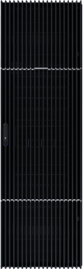
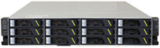
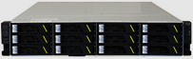
Dorado Competitive Edge - Comprehensive HA/DR Solution
With solution-level reliability measures, Dorado V6 can reach 99.99999%.
Site A
Site B
Synchronous
HyperMetro
Asynchronous
WAN
Oracle RAC
VMware Vsphere
Fusionsphere
Cluster
...
A
B
Asynchronous
A
WAN
B
Asynchronous
WAN
WAN
C
C
FC/IP
Network
WAN
FC/IP
Network
Serial
Synchronous
HyperMetro
Asynchronous
Synchronous Mirroring
WAN
WAN
A
B
A
B
Asynchronous
Asynchronous
WAN
WAN
C
C
IP
Network
IP
Network
Parallel
Production storage
Production storage
Synchronous
HyperMetro
Synchronous
HyperMetro
Site C
A
B
Asynchronous
Standby
A
B
Asynchronous
Asynchronous
WAN
Asynchronous
Standby
WAN
WAN
WAN
Quorum server
C
C
Ring
Front End
Inside
Back End
Outside
Management
Notes:
HyperMetro 3DC reference architecture as shown in the picture
It supports multiple flexible ways of HA/DR, allows it to handle more failure scenarios than competitors
With solution-level reliability measures, Dorado V6 can reach 99.99999% reliability (7 9s, 3 seconds down time per year)

Slide 8
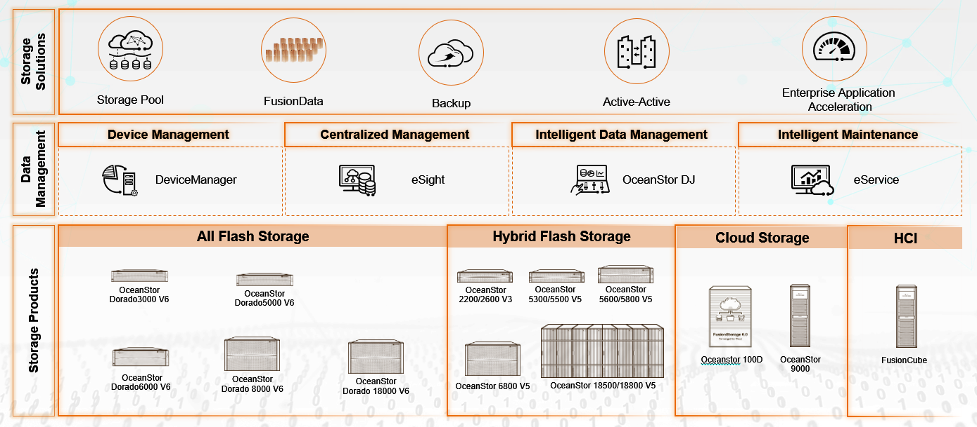
Dorado Competitive Edge – Full Range of Management Software
DeviceManager: Embedded/unified storage system management software to provide full storage system operation capacities, and many ease-of-use features
eSight: Unified ICT management platform of different systems to ensure lower O&M costs and higher efficiency for customers.
OceanStor DJ: Powerful storage provisioning, abstraction, orchestration and automation engine, including multi-vendor support
eService: Cloud- and AIOps-based one-stop IT operation platform. Next-generation intelligent O&M platform designed around Huawei’s storage system management for self-driving autonomous systems
Front End
Inside
Back End
Outside
Management
Notes:
Highlight that 70% cost in modern corporate IT is operation cost rather than equiptment, Huawei has full range of admin software to help make it much easier, and lead to less TCO
Full range of choices fits different scale: node -> cluster -> data center -> cloud, fully graphical with CLI and REST support at many layers
Intelligent: smart chips, systems, and cloud
Feature-rich: planning, deployment, configuration, provisioning, monitoring, optimization analysis, operation control, host auto discovery, centralized management in eSight, O&M, automation engine.
Ease-of: many user-friendly wizards for complex tasks
Unified: one-stop shop to manage all Huawei systems, and can extend to third-party systems via eSight and DJ
Open: RESTFUL, Industry standards (SMI-S), CLI, third-party integration

Slide 9
OceanStor 100D Distributed Storage

Slide 10
Core Requirements for Storage Systems
Distributed Storage Hot Issue Statistics
Scalability
60.7%
60.1%
58.2%
56.6%
51.5%
50.8%
47.3%
36.4%
Performance
Usability
Users'
core requirements
High scalability
Reliability
I/O performance
Usability
Cost
Hotspot performance
Data security
Features
Reliability
Source: 130 questionnaires and 50 bidding documents from carriers, governments, finance sectors, and large enterprises
Cost

Slide 11
Current Distributed Storage Architecture Constraints
Mainstream open-source software in the industry
Mainstream commercial software in the industry
Three steps to query the mapping: LUNs or files are mapped to multiple continuous objects on the local OSD.
User LUN/File
Obj
Obj
Obj
Obj
Obj
Obj
Obj
Obj
Obj
Obj
Obj
Obj
Protection groups (PGs) have a great impact on system performance and layout balancing. They need to be dynamically split and adjusted based on the storage scale. This adjustment affects system stability.
PG
PG
PG
PG
PG
PG
PG
PG
PG
PG
PG
PG
PG
PG
PG
PG
PG
PG
PG
PG
CRUSH map
The minimum management granularity is by object. The size of an object is adjustable, which affects metadata management, space consumption, performance, and even read/write stability.
OSD
OSD
OSD
OSD
Local storage
obj
File
Disk
ID
Binary Data
Metadata

Slide 12
Best Value of OceanStor 100D: Compared with Others
Vendor | Product 1 | Product 2 | OceanStor 100D
Performance | The CRUSH algorithm is simple, but does not support RDMA, and the performance for small I/Os and EC is poor. | Multiple disks form a disk group (DG). One DG is configured with one SSD cache. Heavy I/O loads will trigger cache writeback, greatly deteriorating performance. | End to end NVMe ready, support RDMA connection. High-Ratio EC Aggregates Small Data Blocks and ROW Balances Costs and Performance --- good perf for small IO support both all flash or hybrid Tiering Plog append only but byte addressable interface gains max SSD perf and bridge future SCM. Auto-balance & mutli-tier ensure constant good performance.
Reliability | Design-based CRUSH algorithm constraints: uneven data distribution, uneven disk space usage, and insufficient subhealth processing | Data reconstruction in fault scenarios has a great impact on performance. | Component-Level: Component level high hardware reliability Poduct level: auto-load balancing, effective EC, system health mgmt., to get evenly distributed data distribution and efficient EC. Solution level reliability: active-active redundancy and consistency and remote disaster recovery for core services, for 99.9999% reliability. Most important: the high reliability is not gained at the sacrifice of performance and life.
Scalability | Restricted by the CRUSH algorithm, adding nodes costs high, and large-scale capacity expansion is difficult. | Poor scalability: Only up to 64 nodes a supported. | The cluster can scale up to 4096 nodes. When a node is added, the system incurs fast node balancing, avoiding migration of large data. Disks, computing nodes, and storage nodes could be added separately or together.
Usability | Lack of cluster management and maintenance interfaces with poor usability | Inherit the vCenter management system with high usability. | Easy to use from eveyr beginning: Out-of-the-Box Operation Hardware Visualization Network Visualization Three-Layer Intelligent O&M Ultra-Large Cluster Management and Scaling Three-Layer Intelligent O&M AI based forecast
Cost | Community product with low cost: EC is not used for commercial, and deduplication and compression are not supported | High cost: All SSDs support intra-DG deduplication and non-global deduplication, but do not support compression. EC supports only 3+1 or 4+2. | Powerful global deep dedup and compression create more virtual capacity. Effective erasure coding scheme reduce data redundancy Efficient data tiering for best performance/cost ratio for end-user.

Slide 13
Overall Architecture of Distributed Storage (Four-in-One)
VBS (SCSI/iSCSI)
NFS/SMB
HDFS
S3/SWIFT
Disaster Recovery
HyperReplication
HyperMetro
O&M Plane
Cluster Management
DeviceManger
QoS
License/Alarm/
Log
Authentication
eService
Block
LUN Volume
L1 Cache
File
DriectIO L1 Cache MDS
HDFS
NameNode
Object
LS OSC Billing
Index Layer
Write Ahead Log Snapshot Compression Deduplication Garbage Collection
Persistence Layer
Mirror Erasure Coding Fast Reconstruction Write-back Cache SmartCache
Hardware
x86 Kunpeng
Architecture advantages
Convergence of the block, object, NAS, and HDFS services, implementing data flow and service interworking
Introducing advantages of the professional storage to achieve optimal convergence of performance, reliability, usability, cost, and scalability
Convergence of software and hardware, optimizing performance and reliability based on customized hardware

Slide 14
OceanStor Edge (Arctic)
FusionCube 500

Slide 15
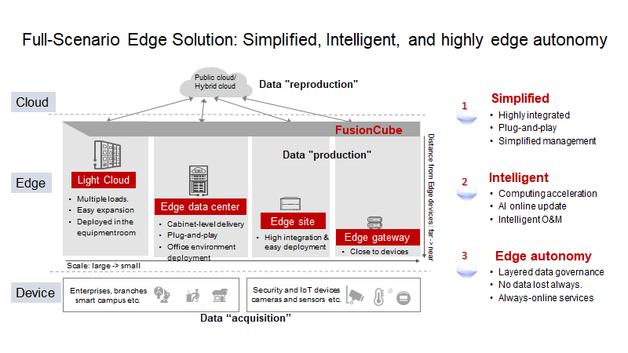
Notes:
High integration: industry-leading "5 in 1" full-stack capability, dustproof, shockproof, noise reduction, and wide environment adaptability;
Plug-and-play: full-stack modular design, cabinet-based delivery, easy installation;
Simplified management: Unified management of devices, resource and applications with intelligent O&M, maximum 20,000 sites support;
Computing acceleration: built-in AI inference card, supporting hardware encoding and decoding, providing powerful computing capability
AI Online Update: Cloud-based training and edge inference, improving AI accuracy
Intelligent O&M: automatic inspection, fault prediction, and self-healing, avoiding service interruption and attendance-free
Edge autonomy: No data loss occurs, providing always-online service, even when cloud and network disconnected by local full-stack capabilities
Hierarchical data governance: shorter latency, better efficiency, and manageable data transferred

Slide 16
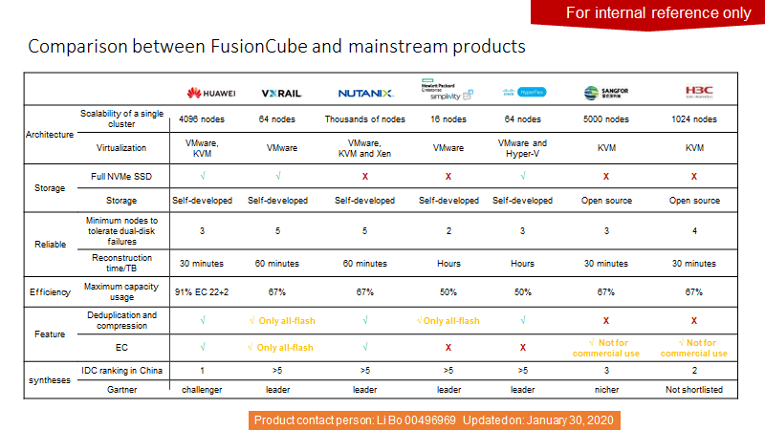

Slide 17
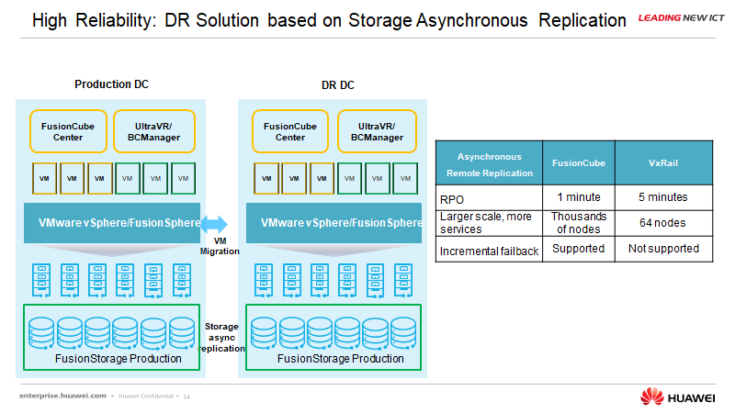

Slide 18
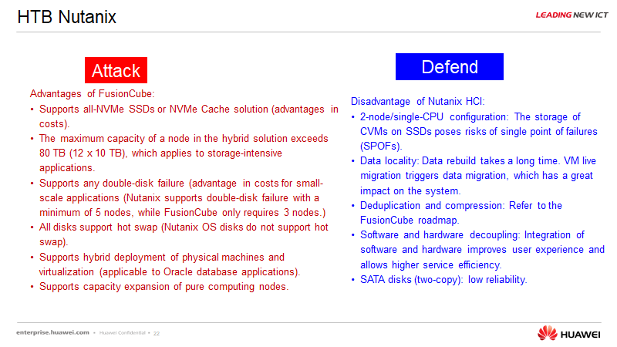

Slide 19
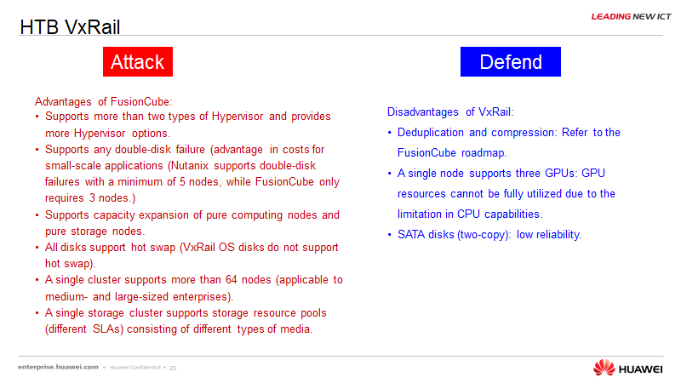

Slide 20
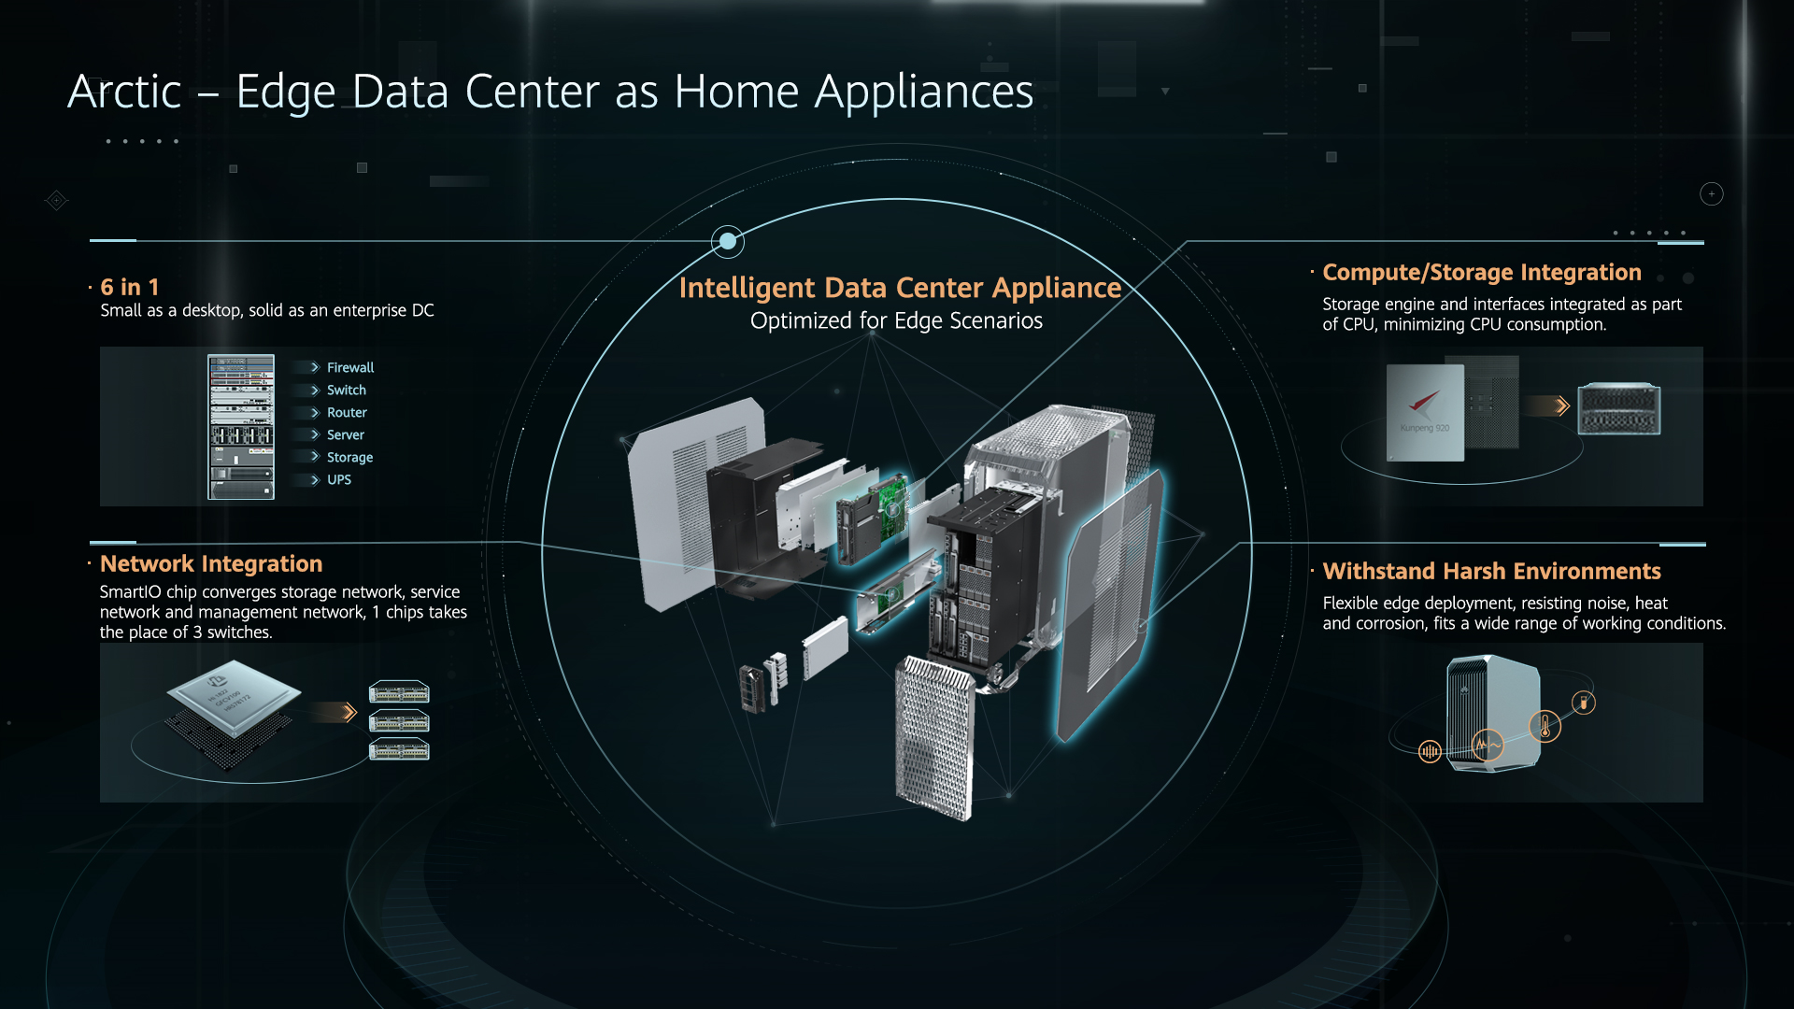
Notes:
FusionCube 500 is one of the FusionCube products which is used as intelligent data center appliance. It is optimized for edge scenarios.

Slide 21
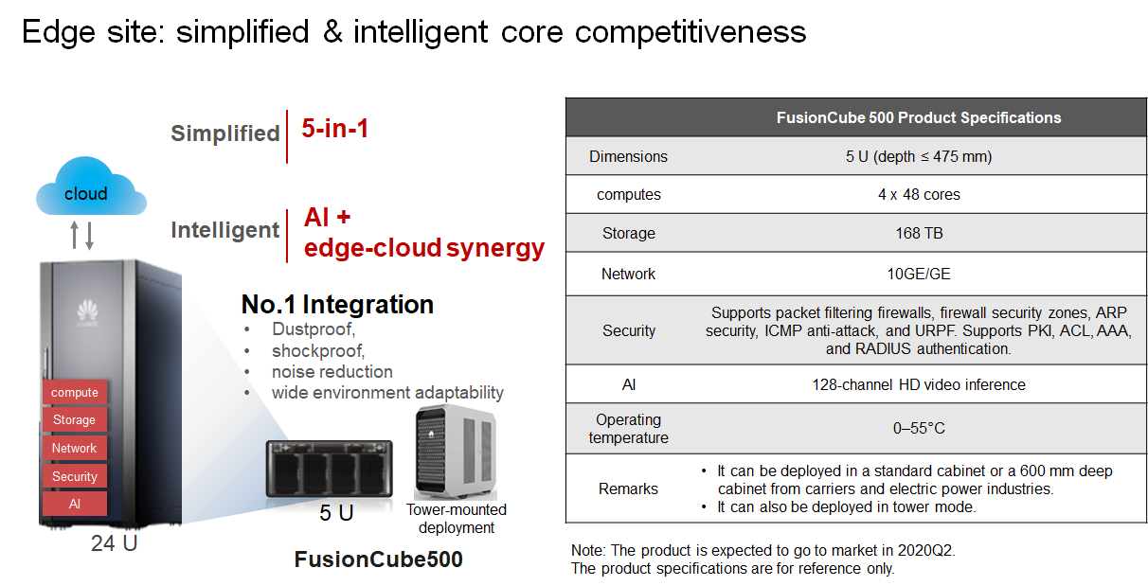
Notes:
High integration and miniaturized appliance: enterprise-level data reliability, applicable to desktop environments without cabinets or air conditioners;
Easy deployment, no switching, light weight, support for home appliance delivery, and plug-and-play;
Low cost: Interface modules are shared. At least two nodes are configured for a single server, reduce the cost by over 20%.

Slide 22
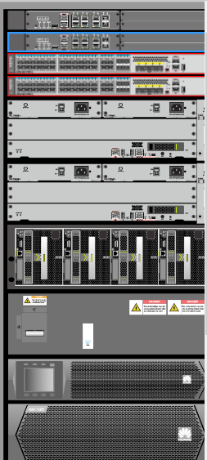
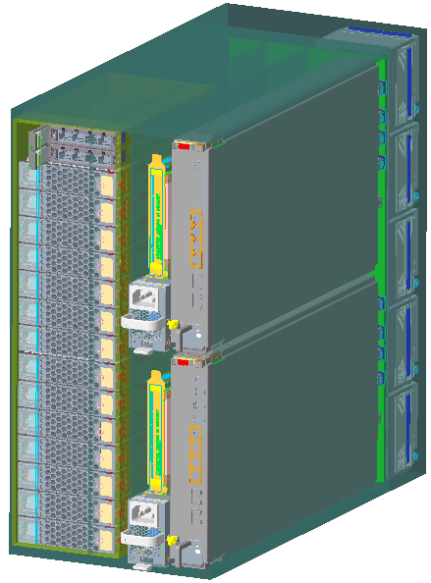
Arctic Ocean: Branch Appliance - Integrated Delivery
High integration and miniaturized appliance: enterprise-level data reliability, applicable to desktop environments without cabinets or air conditioners;
Easy deployment, no switching, light weight, support for home appliance delivery, and plug-and-play;
Low cost: Interface modules are shared. At least two nodes are configured for a single server, reduce the cost by over 20%.
Key Specifications | Requirement Specifications
Chassis | Can be installed in a 600 mm cabinet
Node | 4 nodes per device, 48C+8DIMM/node
Card/Controller | Each node supports two standard cards, and the entire chassis supports two 1822 shared cards for switching.
Hard disk specifications | SSD (slots 0 to 12)/HDD (slots 0 to 9)
Network | Built-in 1822 + vCPE, no switching
Maintenance Mode | One person, single-sided maintenance
Operating temperature | 0-55 degrees Celsius
Weight | 25–30 kg
Noise | 55 dB
Typical Power Consumption | 10 million (maximum)
GA | 12/2020
Firewall
Arctic Ocean
Switch
Server
Storage
UPS+battery pack

